Slide 1
Jefry Sunupurwa Asri, S.Kom, M.Kom
Machine Learning
Pertemuan Ke-2
Introduction to Machine Learning Part 2

Slide 2
VISI
Menjadi perguruan tinggi kelas dunia berbasis intelektualitas, kreatifitas dan kewirausahaan, yang unggul dalam mutu pengelolaan dan hasil pelaksanaan Tridarma Perguruan Tinggi.
MISI
Menyelenggarakan pendidikan tinggi yang bermutu dan relevan
Menciptakan suasana akademik yang kondusif
Memberikan pelayanan prima kepada seluruh pemangku kepentingan

Slide 3
Learning a Class from Examples
Class C of a “family car”
Prediction: Is car x a family car?
Knowledge extraction: What do people expect from a family car?
Output:
Positive (+) and negative (–) examples
Input representation:
x₁: price, x₂ : engine power

Slide 4
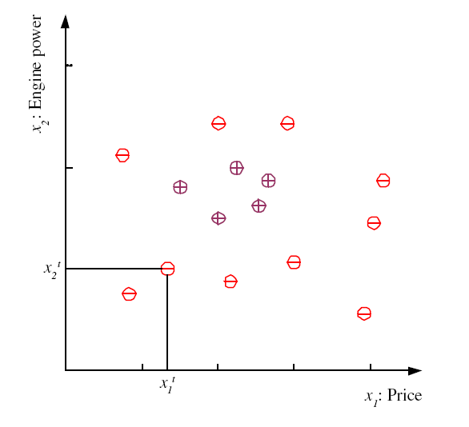
Training set X
4

Slide 5
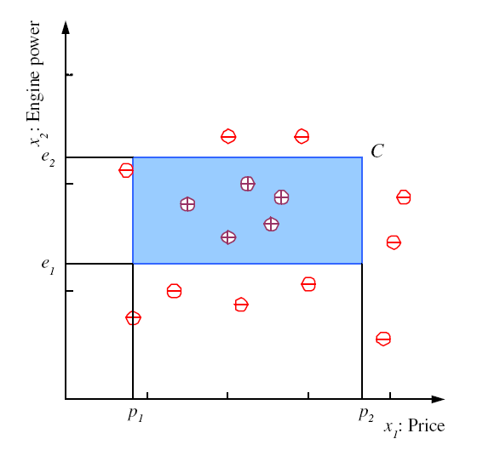
Class C

Slide 6
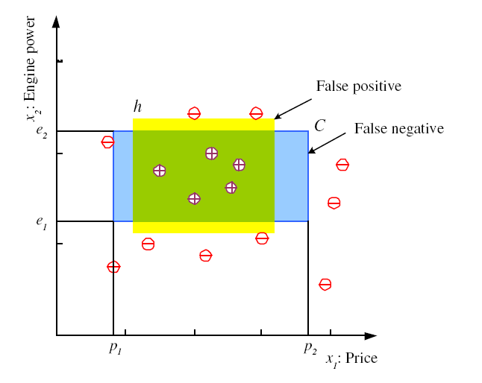
Hypothesis class H
Error of h on H

Slide 7
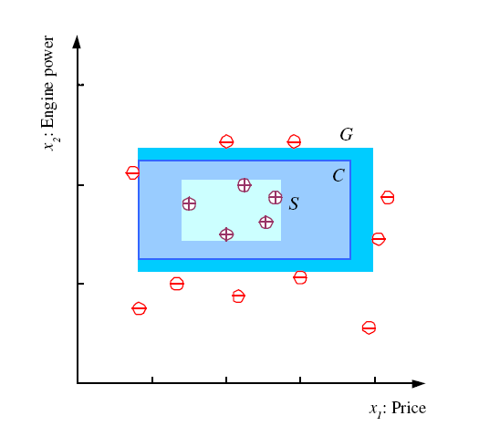
S, G, and the Version Space
most specific hypothesis, S
most general hypothesis, G
h ∈ H, between S and G is
consistent and make up the
version space
(Mitchell, 1997)

Slide 8
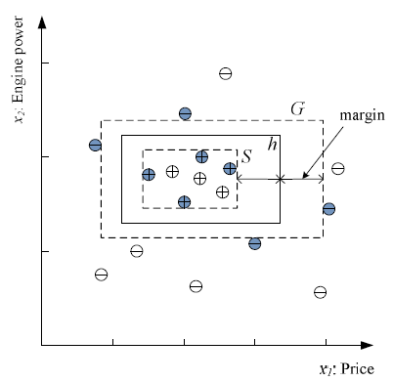
Margin
Choose h with largest margin

Slide 9
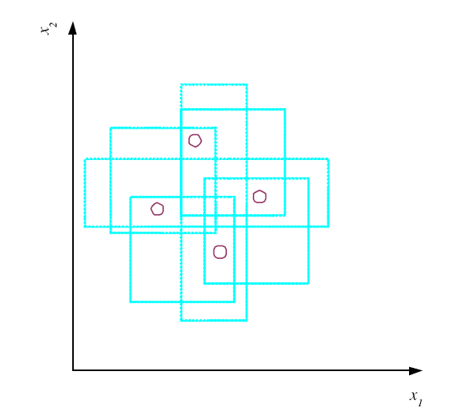
VC Dimension
N points can be labeled in 2^{N} ways as +/–
H shatters N if there
exists h ∈ H consistent
for any of these:
VC(H ) = N
An axis-aligned rectangle shatters 4 points only !

Slide 10
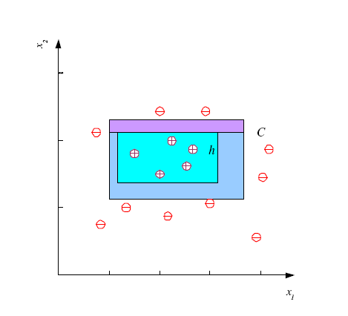
Probably Approximately Correct (PAC) Learning
How many training examples N should we have, such that with probability at least 1 ‒ δ, h has error at most ε ?
(Blumer et al., 1989)
Each strip is at most ε/4
Pr that we miss a strip 1‒ ε/4
Pr that N instances miss a strip (1 ‒ ε/4)^{N}
Pr that N instances miss 4 strips 4(1 ‒ ε/4)^{N}
4(1 ‒ ε/4)^{N} ≤ δ and (1 ‒ x)≤exp( ‒ x)
4exp(‒ εN/4) ≤ δ and N ≥ (4/ε)log(4/δ)

Slide 11
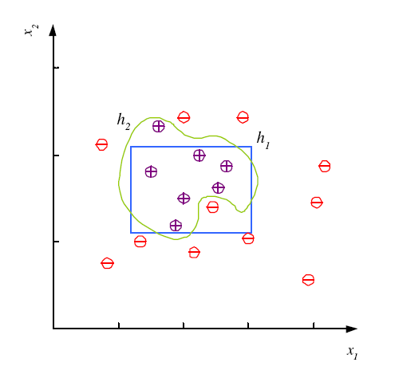
Noise and Model Complexity
Use the simpler one because
Simpler to use
(lower computational
complexity)
Easier to train (lower
space complexity)
Easier to explain
(more interpretable)
Generalizes better (lower
variance - Occam’s razor)

Slide 12
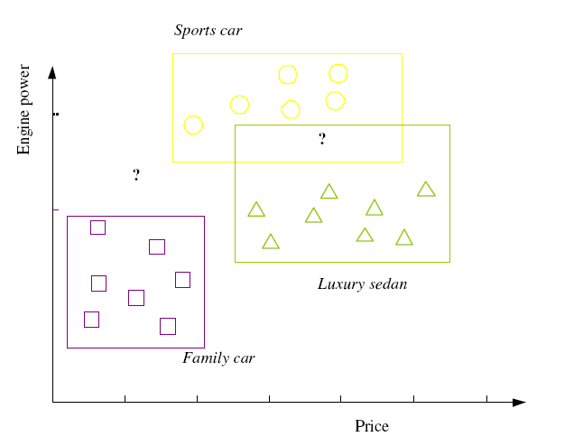

Multiple Classes, C_{i} i=1,...,K
Train hypotheses
h_{i}(x), i =1,...,K:

Slide 13
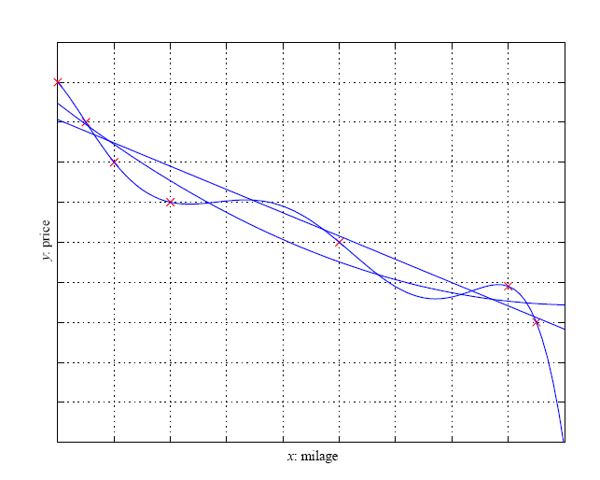
Regression
13

Slide 14
Model Selection & Generalization
Learning is an ill-posed problem; data is not sufficient to find a unique solution
The need for inductive bias, assumptions about H
Generalization: How well a model performs on new data
Overfitting: H more complex than C or f
Underfitting: H less complex than C or f

Slide 15
Triple Trade-Off
There is a trade-off between three factors (Dietterich, 2003):
Complexity of H, c (H),
Training set size, N,
Generalization error, E, on new data
As N, E↓
As c (H), first E↓ and then E

Slide 16
Cross-Validation
To estimate generalization error, we need data unseen during training. We split the data as
Training set (50%)
Validation set (25%)
Test (publication) set (25%)
Resampling when there is few data

Slide 17
Dimensions of a Supervised Learner
Model:
Loss function:
Optimization procedure:

